Slide 1

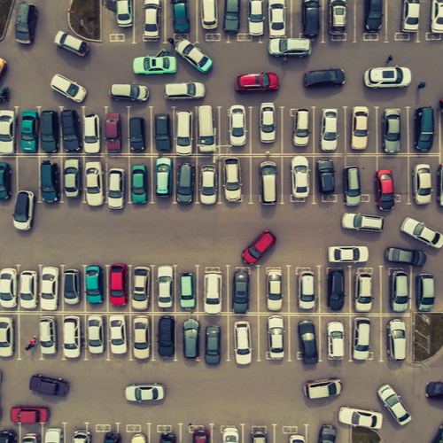
SMART PARKING SYSTEM
INFM 600 PROJECT PRESENTATION
TEAM 6
Aditya Kiran
Jianbo Zhang
Mingxi Xu
Sadaf Davre
Satvir Singh
Tanya Gupta
Yogesh Boricha

Slide 2
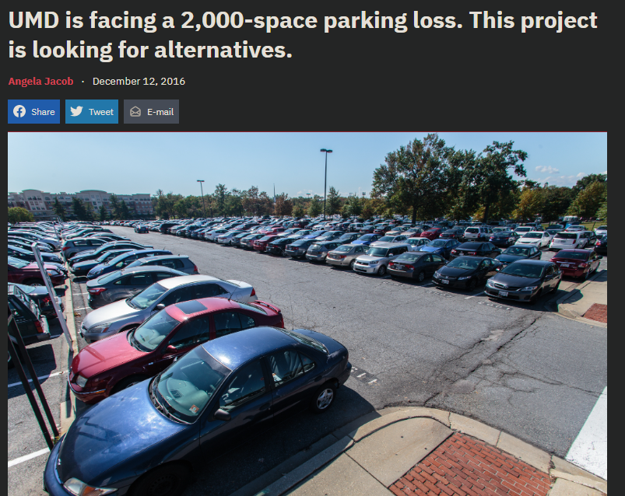
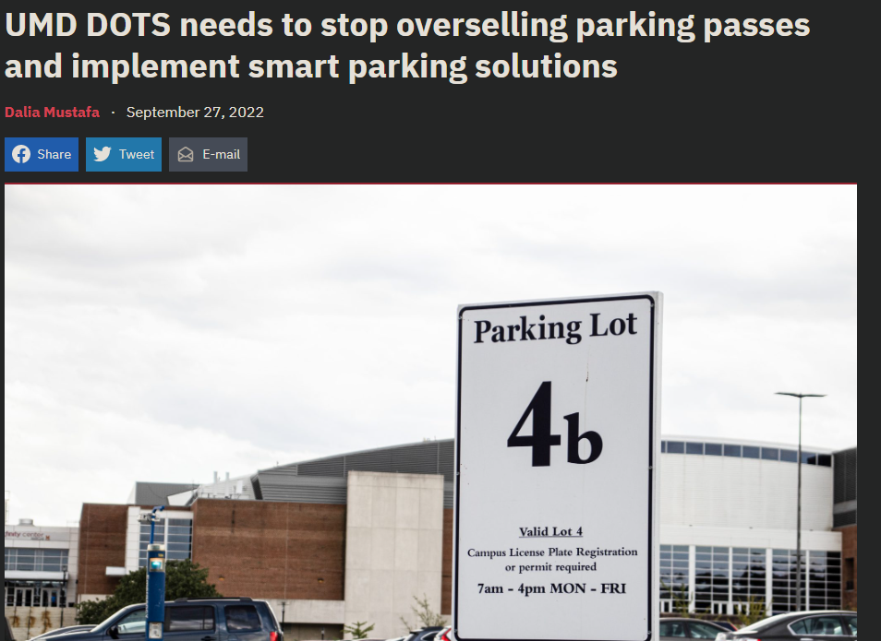
INTRODUCTION
Several articles have been published discussing the poor parking system at the University of Maryland.
Smart Parking System is to improve the car parking experience for the students at the University of Maryland(UMD).
Currently, the parking system is a mess where a student can buy a parking spot for a year/semester, but might not find a parking spot.
With this project, we aim to solve this problem by providing a parking management system that intelligently keeps track of all the parking slots and assigns an empty parking slot depending on the student’s class location and timing.

Slide 3
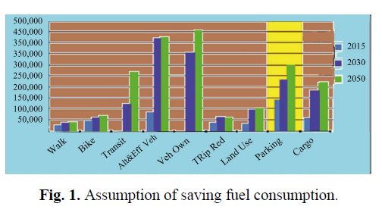
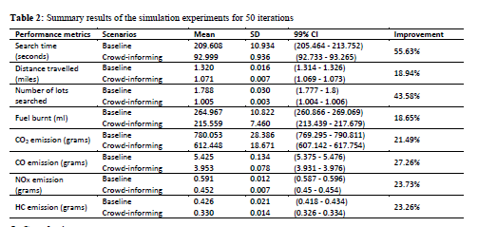
DATA COLLECTION
The Data From University Campuses
In Fig.1, if the smart parking system is used on the university campus, it is predicted that a lot of fuel resources will be saved and the protection of the environment will be achieved[1].
In Table 2, users looking for parking spaces through the smart parking system can reduce the time of querying parking spaces, waiting time, fuel consumption and exhaust emissions[2].
[1] A. Ahad, Z. R. Khan, and S. A. Ahmad, “Intelligent Parking System,” World J. Eng. Technol., vol. 4, pp. 160–167, 2016.
[2] Rahman, Md Mamunur, Mateo Anthony Galvez, and Yuan Zhou. "Evaluation of' Crowd-informing'on Parking Performance and Environmental Emissions: An Agent-Based Simulation of an Urban University Campus." IIE Annual Conference. Proceedings. Institute of Industrial and Systems Engineers (IISE), 2021.

Slide 4
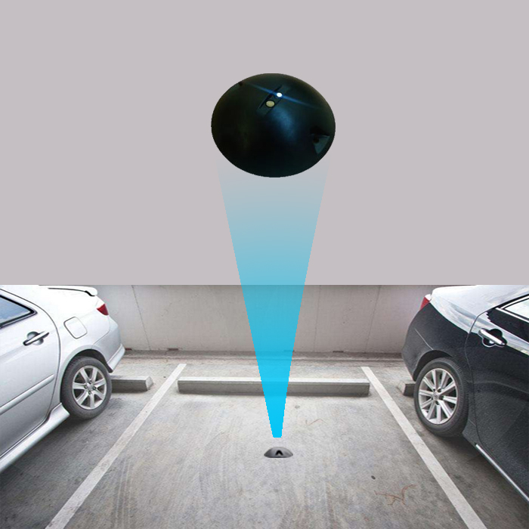
IMPLEMENTATION
A sensor will need to be placed at each and every parking spot at UMD.
This sensors communicate with the parking system database via Wi-Fi. University of Maryland has Wi-Fi coverage all across campus which enables us to easily do this.
The parking system updates the parking space database.
The user can access the system using an Android/iOS application.

Slide 5
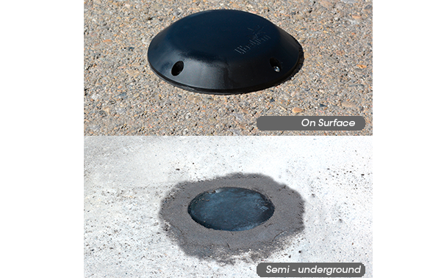
PARKING SENSOR
Libelium offers parking sensors for both parking lots and garages. These detectors are wireless and connect via Wi-Fi. One perk of their system is that the implementation can be done semi-underground, thus allowing there to be less risks imposed. Key features: 10+ years battery life and waterproofing.
Notes:
Libelium is a cloud based IoT product provider which specializes in sensor systems. They have a very modern and seamless design approach which allows for solutions to be developed efficiently.

Slide 6
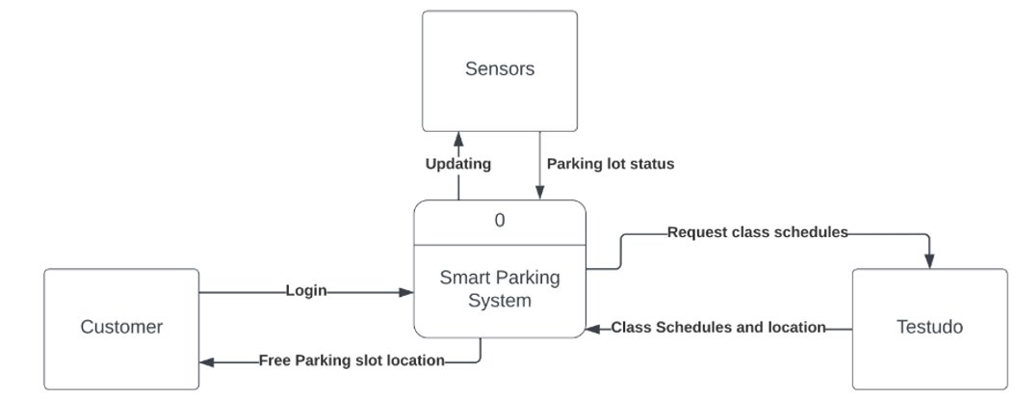
CONTEXT LEVEL DFD

Slide 7
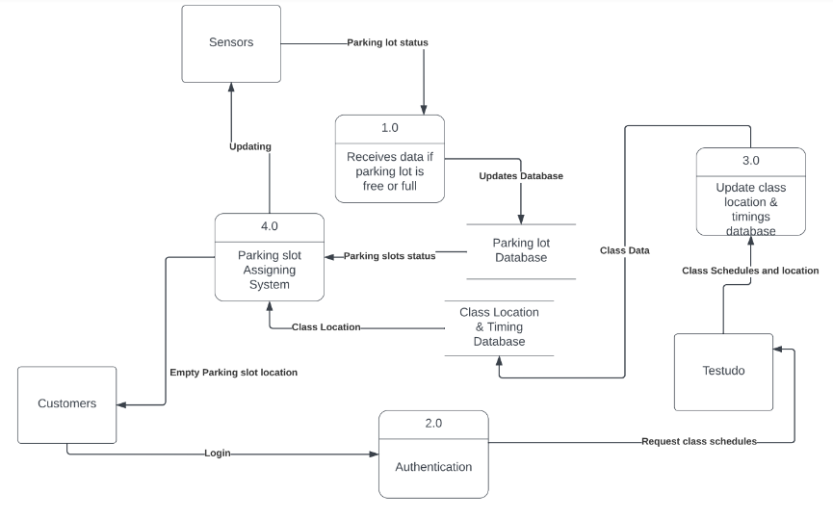
LEVEL-0 DFD

Slide 8
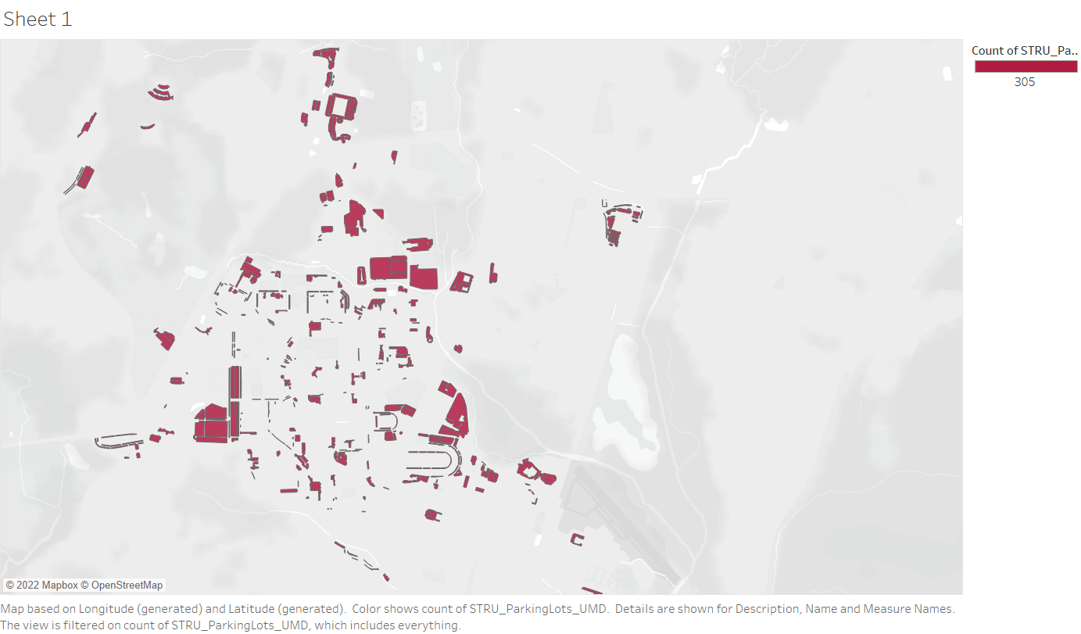
TABLEAU VISUALIZATION MAP
This Map was created in Tableau from the KML dataset obtained from Maryland.gov
This represents all the parking spots in college park campus.

Slide 9
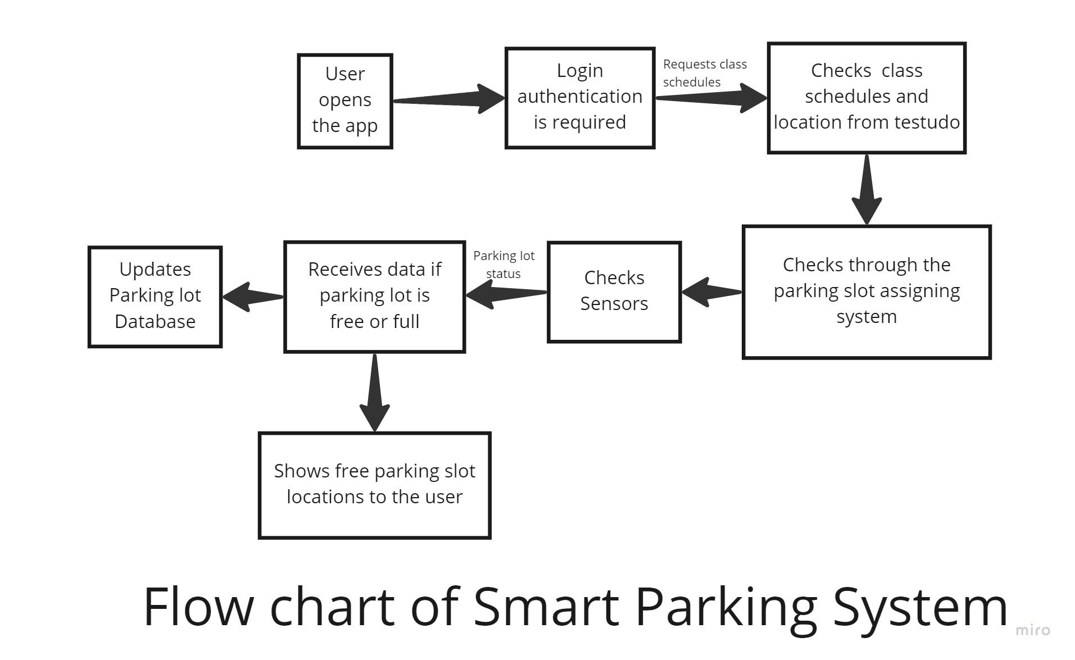
FLOW CHART

Slide 10
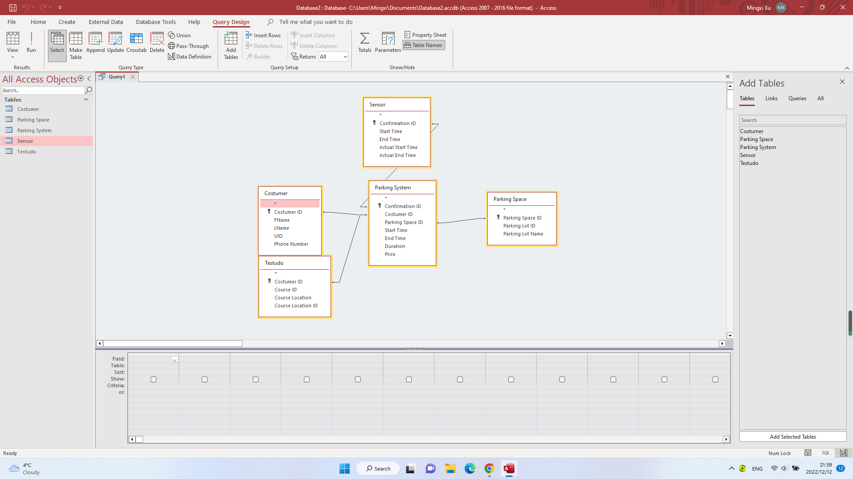
ENTITY-RELATION DIAGRAM

Slide 11
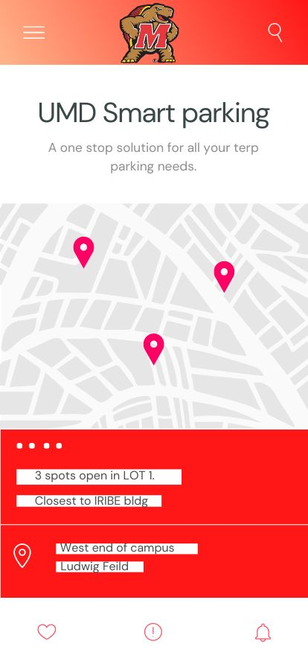
USER INTERFACE
“Smart parking app”
Clean, user-friendly interface
Would require Two-Factor Authentication from the Duo Push App
Would show the estimated distance between free parking lots and buildings in which the users classes would happen
Would show time remaining and options to increase the parking space time
Easy accessibility

Slide 12

CHALLENGES/RISKS
Power/Network Outage
Initial costs to install sensors and infrastructure
Finding the appropriate contracting services for installation/maintenance
Database management
It does not account for inclement weather or any other emergency
Cybersecurity to protect user privacy information

Slide 13
REFERENCES
https://data.imap.maryland.gov/datasets/24b87c89e37946b1b444177fd3c9c848/explore?location=38.991162%2C-76.934073%2C14.77
https://dbknews.com/2022/09/27/umd-parking-nightmare-tech-solutions/
https://dbknews.com/2016/12/12/university-of-maryland-parking-space-alternatives/
A. Ahad, Z. R. Khan, and S. A. Ahmad, “Intelligent Parking System,” World J. Eng. Technol., vol. 4, pp. 160–167, 2016.
Rahman, Md Mamunur, Mateo Anthony Galvez, and Yuan Zhou. "Evaluation of' Crowd-informing'on Parking Performance and Environmental Emissions: An Agent-Based Simulation of an Urban University Campus." IIE Annual Conference. Proceedings. Institute of Industrial and Systems Engineers (IISE), 2021.

Slide 14


